Slide 1
Calculator with matrix
Prepared by
G.Dakshayani
S.Supriya
A.Roopa

Slide 2
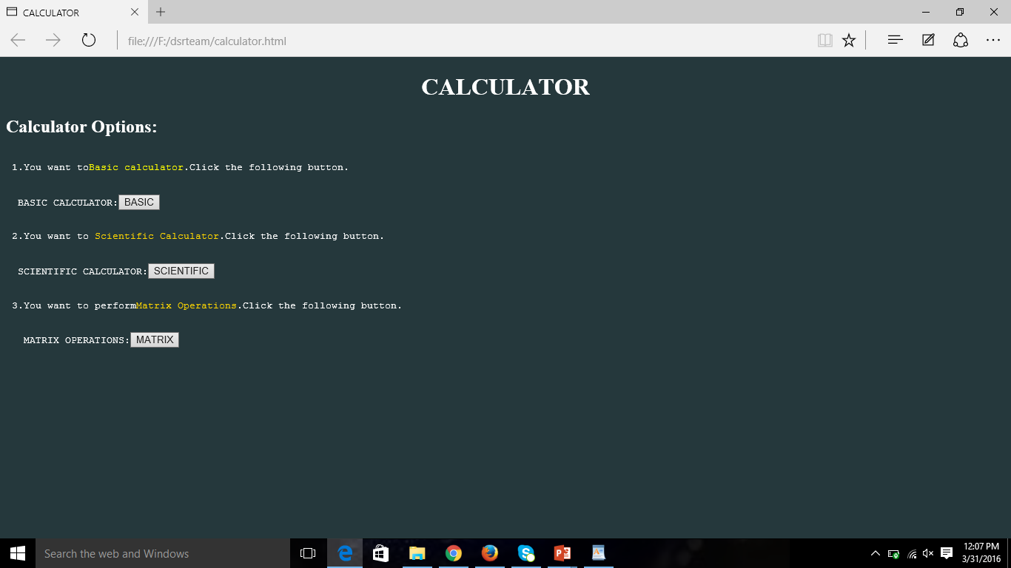
Calculator operations

Slide 3
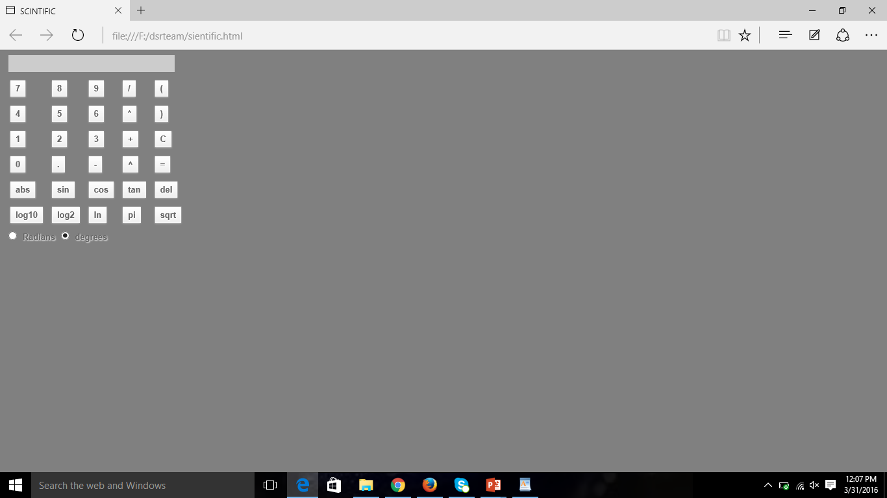
Scientific calculator

Slide 4
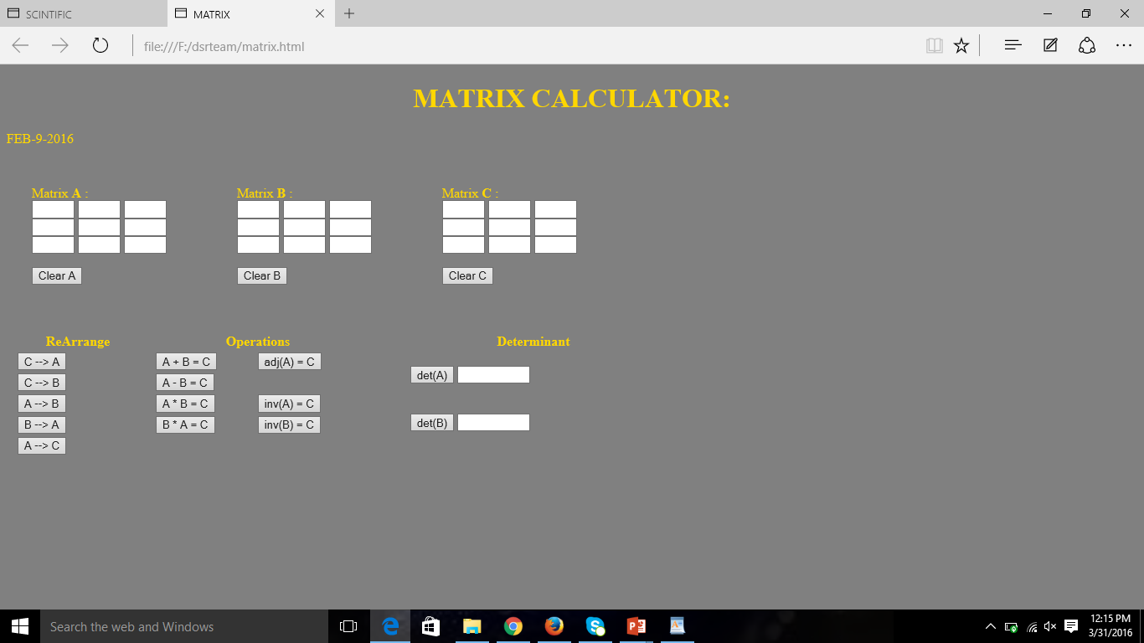
Matrix calculator

Slide 5
THANK YOU

